Slide 1
Community Day Date Proposal
Year | Proposed Date
2022 | Saturday, August 27
2023 | Saturday, August 26
2024 | Saturday, August 24

Slide 3
Projects 2021 (Updated 10/12/2021)
Item | Cost | Year | Notes
Community Center Door | $29,340 | In Progress | P&R
Complete Needs Assessment and Create a P&R Strategic Plan | $25,000 | In Progress | P&R
Bike Paths Repair | $22,000.00 | Complete | Part of Three-Year Plan P&R
Memorial Park | $500.00 (Temporary Solution) | Complete | Budget Complete Rehab of $60,000 in 2023.
Field Grinding and Turface 1 Field Township | $6,000 | Complete | PAA completed 2 fields $12,000
Pool Repairs | 60,000 |  | Slide Cracks, High Dive, fridge Repair, Slide Pump, Light poles,

Slide 4
Projects 2022 (Updated 10/12/2021)
Item | Cost | Year | Notes
Community Park Tennis Courts Repair Crack fill and patch | $60,000.00 | 2022
Woodside Rd. Bike Path | $610,000.00 | 2022
Memorial Park Project (Tennis and Pickleball) | $800,000 | Started in 2021 complete in 2022 | Matching DCNR Grant of $250,000
Bike Paths Repair | $60,000 | 2022 | Part of Multi-Year Plan

Slide 5
Cont. Projects 2022 (Updated 10/12/2021)
Item | Cost | Year | Notes
2x Fields Caiola Turface | $12,000 | 2022 | Improve Drainage (PAA Assist for additional Fields)
Memorial Park East Project (Pavilion) | Waiting on updated cost estimate |  | Fee in Leu
Community Trail | $780,000 |  | $700.000 TAP Grant

Slide 6
Projected 2023 Projects
Item | Cost | Year | Notes
Schuyler Tennis Courts | $50,000-$200,000 | 2023
Memorial Park (Playground Rubberization) | $60,000 | 2023 | 7-year cycle
Bike Paths Repair | Waiting on updated estimates | 2023 | Part of Multi-Year Plan
Memorial Park East Project (Playground) | $500,000-1M | 2023
Pocket Park Playground Replacement (lifecycle replacement) | $200,000 | 2023 | 1 Park/Full Update (Heacock)

Slide 7
Cont. Projected 2023 Projects
Item | Cost | Year | Notes
ADA upgrades Veterans square | $65,000 | 2023 | ADA Transition Plan
Rehab Macclesfield Park Baseball Fields | $750,000

Slide 8
Fee Changes for 2021
Line Item | Current | 2021 Fee | Measurement
Pool membership Fee Increase |  |  | Wage increases to compare to market standard
Summer Camp |  |  | Wage increases to compare to market standard
Swim Team |  |  | League Fees
Pool Picnic Pavilion (Members only) | 10HR | 15HR | Per day during pool open hours
Swim Lessons First Child | $45 | $50
Swim Lessons (additional Children) | $35 | $40
Private Swim Instruction Semi-Private Lesson Up to 3 Each additional student | $25 - | $25 $15 | ½ Hour Semi Private be like levels (Swim test required before first lesson)

Slide 10
Naming Policy

Slide 11
Project UPDATES
Memorial Park
Community Park
Boy Scout
Shade Structure-Veterans Square
Shade Structure Dog Park
Signs at Memorial Park

Slide 13
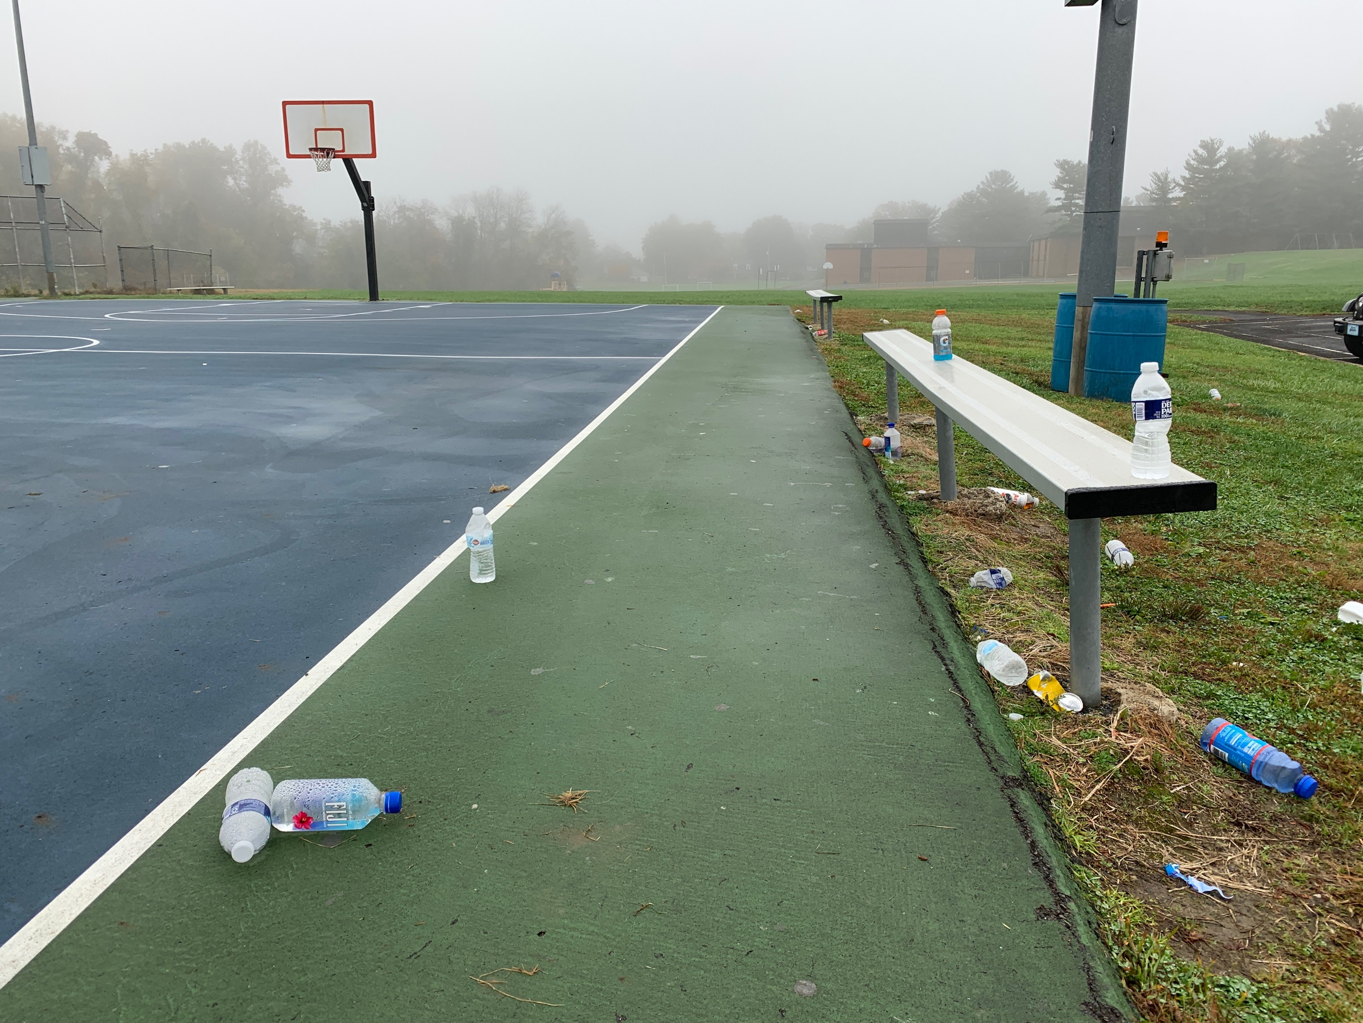
Zero Waste – Baseline
12 Waste Receptacles – 1 Recycle Bin
Varying Receptacles in color shape/size/Color
Minimal Labeling

Slide 14
Zero Waste – Where we need to be
Create a recycling opportunity per waste receptacle
Align Plan with ADA Transition Plan
Develop a plan for special events
Develop a Way to measure the success of the program
Educate the Community and Staff

Slide 15
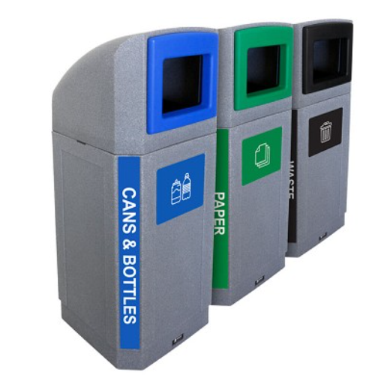
Zero Waste – Getting Started
Complete a receptacle Inventory
Identify a layout for in season and off season for all waste and recycling receptacles.
Define a unified look for receptacles
Identify Barriers
Define funding

Slide 16
Zero Waste Education
Create a nudge campaign in all parks.
Suzy Recycles, How about you?
Easily identifiable consistent look and feel across all parks
Provide education to staff.

Slide 17
Barriers
Contamination Charges
Manpower
Finance
Education

Slide 19
Maintenance and Operations
Modernizing our processes
Classifying parks and facilities based on their usage
Creating check Lists for staff
Schedules for annual maintenance
Reviewed Annually

